Slide 1
Shadheen - UI & UX
Shadheen - Online Employment Exchangement Portal

Slide 2
Group Members
Asifujjaman Opi - 011181295
Md. Shahriar Asif Rezan -011181040
Khorshed Alam - 011181173
Apu Chandra Bhowmick - 011181291
Md. Sabbir Sarkar - 011181197

Slide 3
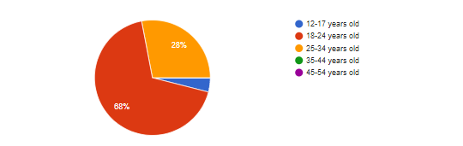
What is your age ?

Slide 4
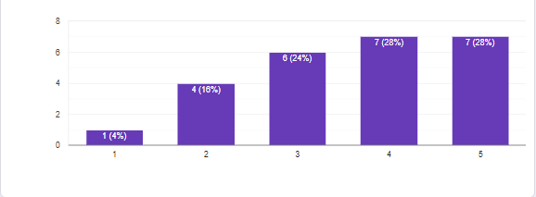
On the scale of 1-5, how do you rate your technical skill ?

Slide 5
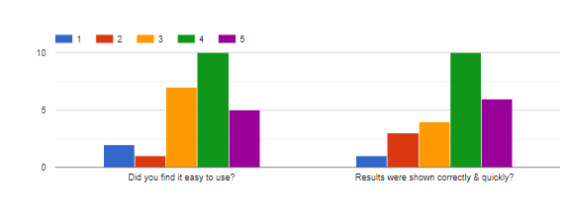
How do you like our "Home Page" feature ? | Decision
 | We need to improve our frontend with modern layout. We need to add more shortcuts to our features.

Slide 6
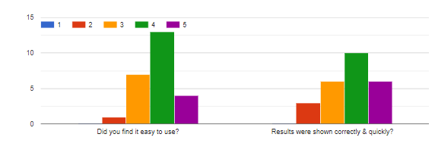
How do you like our "Create CV" feature ? | Decision
 | We need to improve our design part. We need to add some others features also.

Slide 7
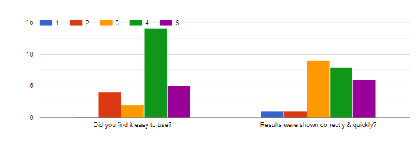
How do you like our "Search Filter" feature ? | Decision
 | As people voted this user interface is easy to use and results are accurate so we do not need to work on this feature anymore.

Slide 8
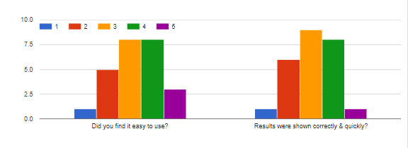
How do you like our "Browse Category" feature ? | Decision
 | As people voted this user interface is easy to use we do not need to redesign.

Slide 9
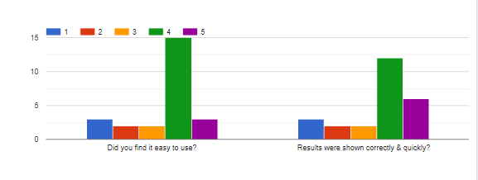
How do you like our "Job Feed" feature ? | Decision
 | We need to make the job feed more compact. Also we need to personalize job feed.

Slide 10
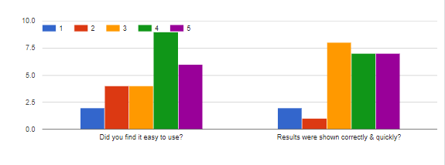
How do you like our "Post Job" feature ? | Decision
 | We do not need to redesign that user interface. We will implement boost job later.

Slide 11
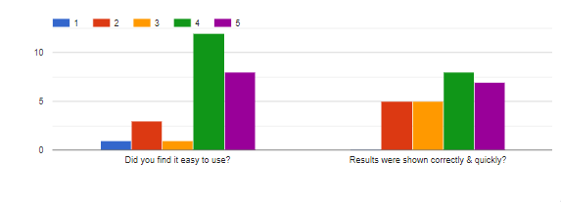
How do you like our "CV Search" feature ? | Decision
 | We do not need to improve design part. Need to improve functionality in this feature.

Slide 12
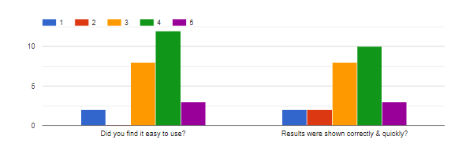
How do you like our "Message" feature ? | Decision
 | No need to improve design part. We can improve user experience.

Slide 13
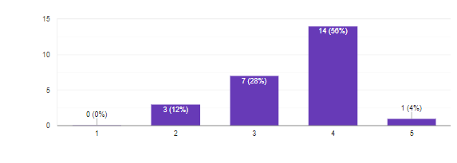
How much did you find our site similar with other sites? | Decision
 | Mapping: We tried to make our user interface look like similar to others. But we will preserve our unique design.

Slide 14
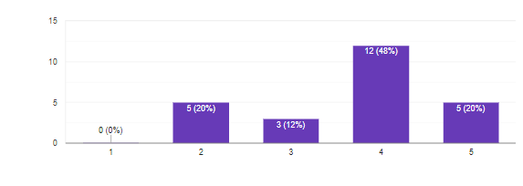
Did you find all our features descriptive enough? | Decision
 | Visibility: Need to improve our site visibility part.

Slide 15
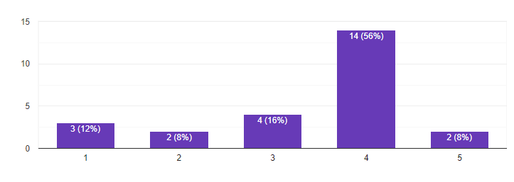
Did you find flow of data useful to visualize? | Decision
 | Consistency: Our data flow visualization is good. So we don’t need to improve.

Slide 16
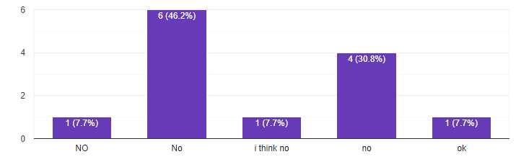
Did you find any unnecessary options that made you confused? | Decision
 | Minimalism: We do not need to improve on this.

Slide 17
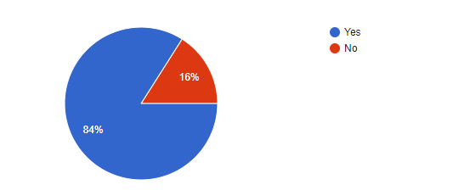
You find all the feature handy when you need? | Decision
 | Recognition: We need to improve on shortcuts part.

Slide 18
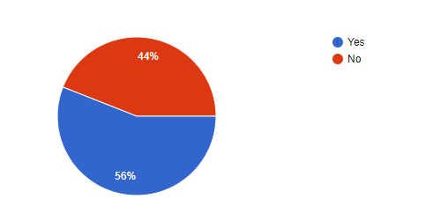
Did you expected guidelines on how to use our website? | Decision
 | Help: We need to write down some guideline.

Slide 19
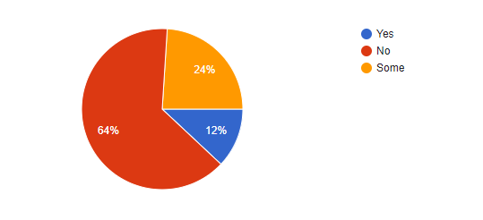
Did you find inconsistency in pages in our website? | Decision
 | Consistency: We need to redesign some of our pages to look more alike.

Slide 20
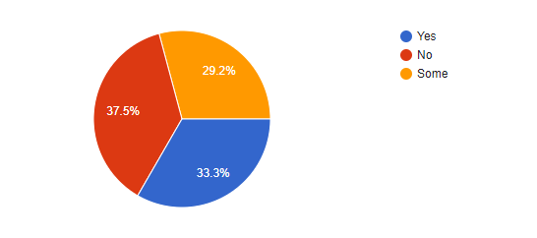
You can undo mistakes that you made? | Decision
 | Error Recovery: This is the most lacking part in our project. Need to improve.

Slide 21
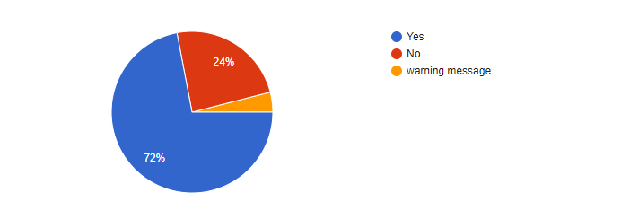
You were warned about errors that should be notified? | Decision
 | Error prevention: We need to be careful about waring part.

Slide 22
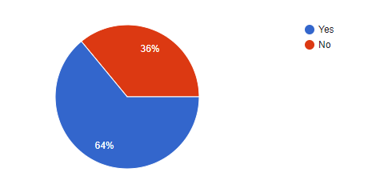
Did you expect more compact version of user interface? | Decision
 | We need to improve out design with the trend.

Slide 23
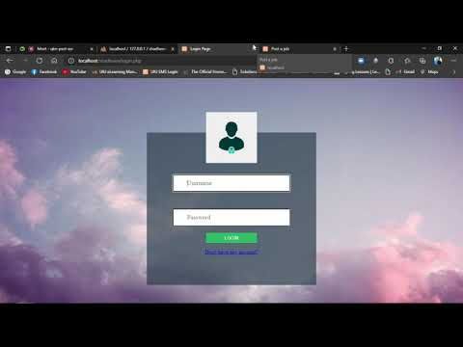

Slide 24
Video Link:-
Shadheen - Demo 1 - YouTube

Slide 25
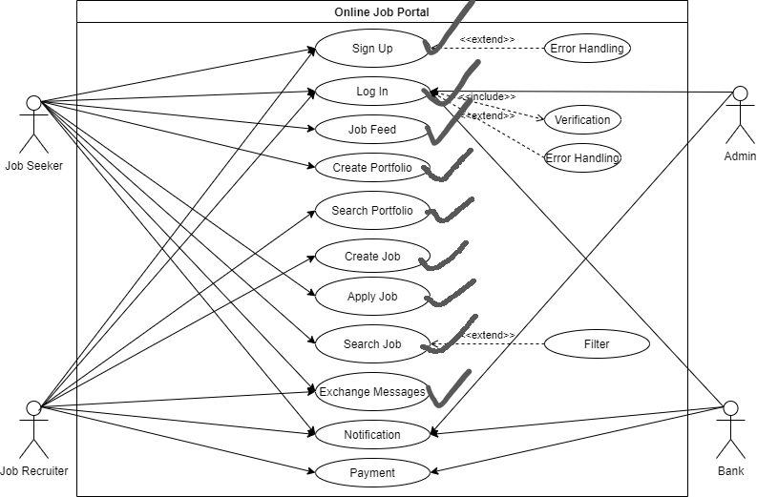

Slide 26
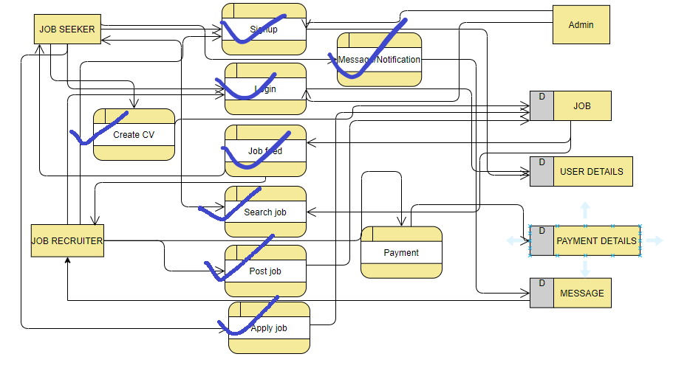

Slide 27
